Slide 1
Band Essentials for Worship
Using the Nashville Number System in a Worship Service
Notes:
LUCAS: Welcome everyone! Today’s instrumental workshop is called Band Essentials for Worship, and it’s all about using the Nashville Number System in a worship service. The goal is for each of you to be able to ”Know how to use the Nashville Number system during worship and underscoring speaking moments.”
Some of you may be asking, “why the Nashville Number system,” or maybe, “why is this important for me today?” and it all comes back to our mission.

Slide 2
Changing lives, communities, and the world for Jesus Christ…
Core Value 3: Pursue Excellence
We share a desire to excel in musicianship and continually develop the talents God has given us.
Notes:
LUCAS: Our mission is… one of our values is pursuing excellence in our worship services… Psalm 33:3 says, “Sing unto Him a new song; play skillfully with a loud noise. For the word of the Lord is right; and all His works are done in truth.”
Learning the Nashville Number system equips us to be better musicians and enables us to play more skillfully together, fulfilling part of this command of scripture.

Slide 3
On a practical level…
Some guitarists use capos.
Quicker, clearer chord callouts.
Easier for MD; no problem if they forget the key.
Easier to identify numerical versus alphabetical patterns.
Notes:
LUCAS: On a practical level… [go through list]. Now what if you already know the Nashville Number system, or you don’t use chords at all to play music (drummers)? We assure you – today’s lesson has something for everyone. Once we cover Nashville Numbers, we’ll talk about following your WL, MD, and CP during worship and underscoring while using NN’s.
So hang tight and follow along! This is good for everyone to know. (Pass the ball to Peyton).

Slide 4
Nashville Numbers 101
Notes:
PEYTON: There are 7 letters that we use in music to define notes. There are 12 notes in an octave, because we sometimes add sharps/flats between the 7 letter-notes. I don’t personally know why music is written this way – it just is. If you’re curious about it, we can talk about music history later. For now, let’s focus on how these letters interact with one another to create music.

Slide 5
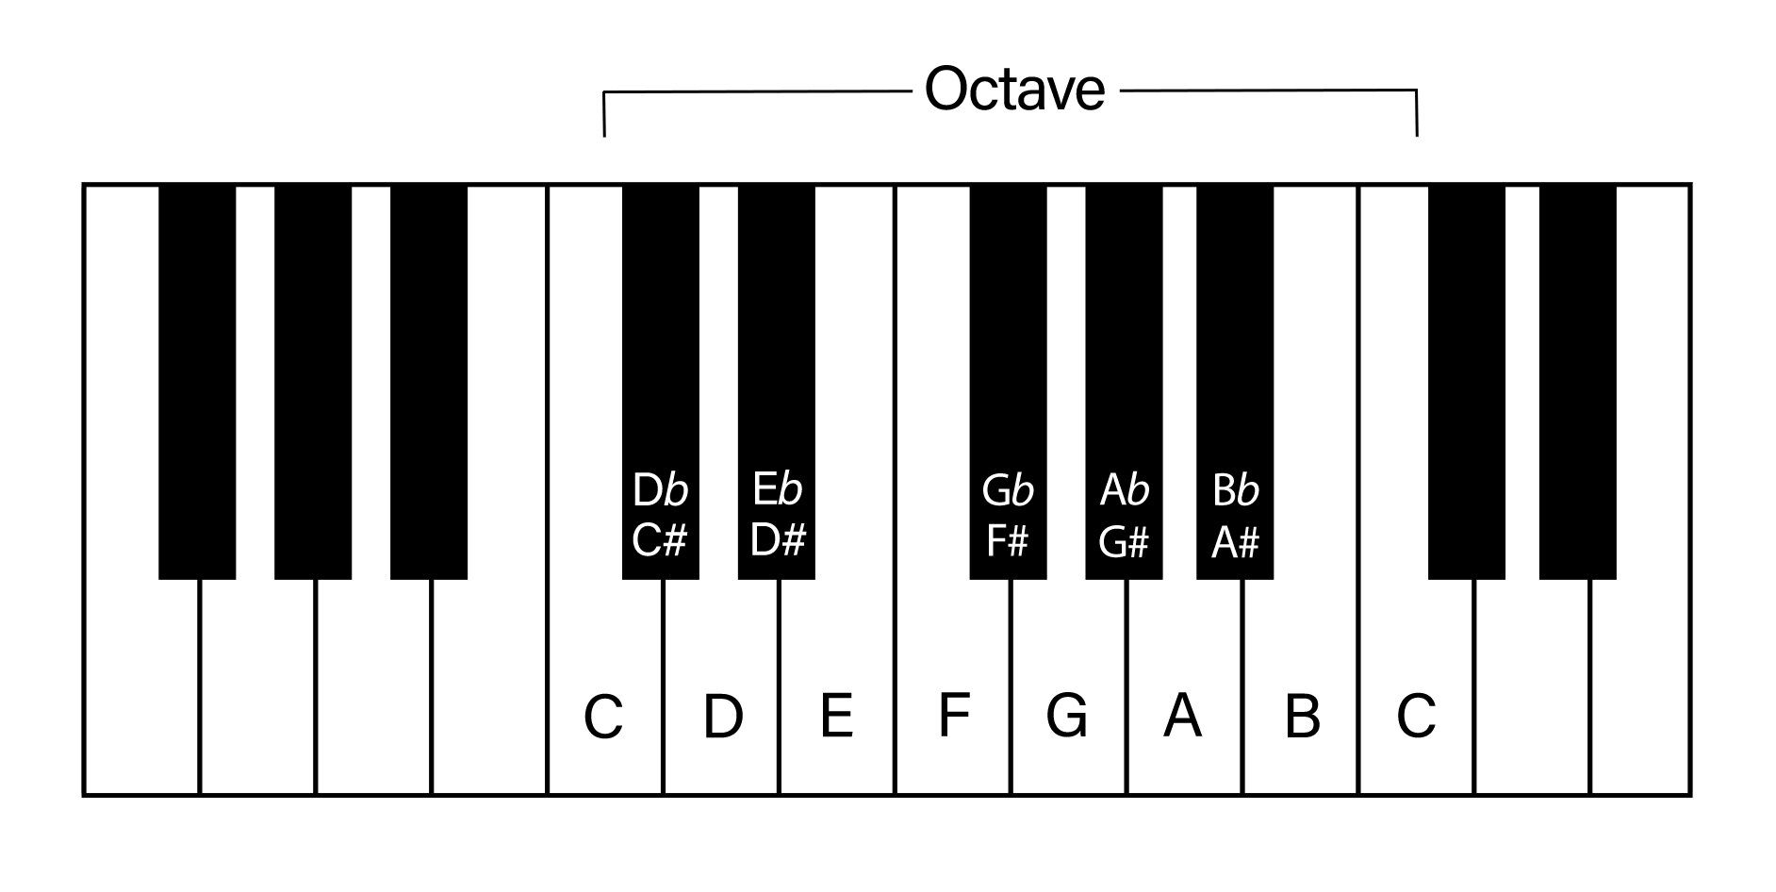
Nashville Numbers 101
W = Whole step
H = Half Step
Major Scale Builder:
WWH W WWH
___________
C Major: C - D - E - F - G - A - B - C
Number: 1 – 2 – 3 – 4 – 5 – 6 – 7 – 1
Notes:
PEYTON: MAJOR SCALE: The major scale consists of 7 notes, and it sounds like this [Greg demonstrate in C]. How do we write this out? Well first, you need to know what key you’re in. We have the key listed at the top of all the chord charts that we use on Sundays. Let’s say we’re in C.
In order to create a C scale out of the 7 notes that naturally occur in the key, we are going to use the “Major Scale Builder” template here. This tells us what kind of steps to take while looking at this chart to create a major scale from any starting note. [Demonstrate by starting on C, then reveal the answer].
Next, we are simply going to assign numbers to the letters in this scale. [Demonstrate, then reveal].

Slide 6
Nashville Numbers 101
W = Whole step
H = Half Step
Major Scale Builder:
WWH W WWH
___________
A Major: A - B - C# - D - E - F# - G# - A
Number: 1 – 2 – 3 – 4 – 5 – 6 – 7 – 1
Notes:
PEYTON: Let’s try it in another key – the key of A major. Find the starting note, then use the ”Major Scale Builder” to create an A Major scale.
Great! Now we need to talk about chords…

Slide 7
Nashville Numbers 101
C Major: C - D - E - F - G - A - B - C
Number: 1 – 2 – 3 – 4 – 5 – 6 – 7 – 1
________________
Building Chords (Triads)
C chord: C - E - G
1 chord: 1 - 3 - 5
A chord: A - C - E
6 chord: 6 - 1 - 3
(Major)
(minor)
Notes:
PEYTON: A chord is made when you take a few notes in the same key and play them altogether. This most often occurs in the form of a triad of notes, and triads are the foundation of every chord. You have a 1st, 3rd, and a 5th.
A triad is made by starting with a single note in the scale, then selecting the 3rd and 5th notes after your starting note [demonstrate]. These three notes, or triad, make up a single chord when played together, and that chord is named by the letter you started with. So, if you started with C and went, “C – E – G” then you have a C chord. If you started with A, then you would have “A – C – E”, which would be an A chord.
Chords have major, minor, and sometimes diminished qualities depending on what kind of sound they make. Major Chords sound happy and joyful, minor chords sound sad and foreboding. [Greg help demonstrate with sound]. Based on sound and feel, is the C chord major or minor? What about the A chord? [Demonstrate].
Therefore, these chords are C Major and A minor when we’re in the key of C.

Slide 8
Nashville Numbers 101
Building Chords (Continued)
Key of C Scale: C - D - E - F - G - A - B - C
C chord = 1 chord (Major)
Dm chord = 2m chord
Em chord = 3m chord
F chord = 4 chord
G chord = 5 chord
Am chord = 6m chord
Bº chord = 7º chord (rarely used)
Chord | Nashville Number | Quality
C | 1 | Major
Dm | 2 | minor
Em | 3 | minor
F | 4 | Major
G | 5 | Major
Am | 6 | minor
Bdim | 7º | diminished
*Chord qualities for numbers are always the same, regardless of the key.
Notes:
PEYTON: When we apply these triad-building rules to every note in the C scale, and build a triad chord from each note, these are the chord qualities they produce.

Slide 9
Practice Worksheet
Assign chord numbers/qualities to the key of A
Key of A Scale: A – B – C# – D – E – F# – G# – A
Key of A | Number
A | 1 (Major)
B
C#
D
E
F#
G#
*Chords will either be major, minor, or diminished.
Notes:
PEYTON: Now take a moment to try it yourself in another key!

Slide 10
Practice Worksheet
Assign chord numbers/qualities to the key of A
Key of A Scale: A – B – C# – D – E – F# – G# – A
Key of A | Number
A | 1 (Major)
B | 2 (minor)
C# | 3 (minor)
D | 4 (Major)
E | 5 (Major)
F# | 6 (minor)
G# | 7 (diminished)
*Chords will either be major, minor, or diminished.
Notes:
PEYTON: Here are the correct answers. Let’s put this in the context of a song we do on Sundays [next slide]

Slide 11
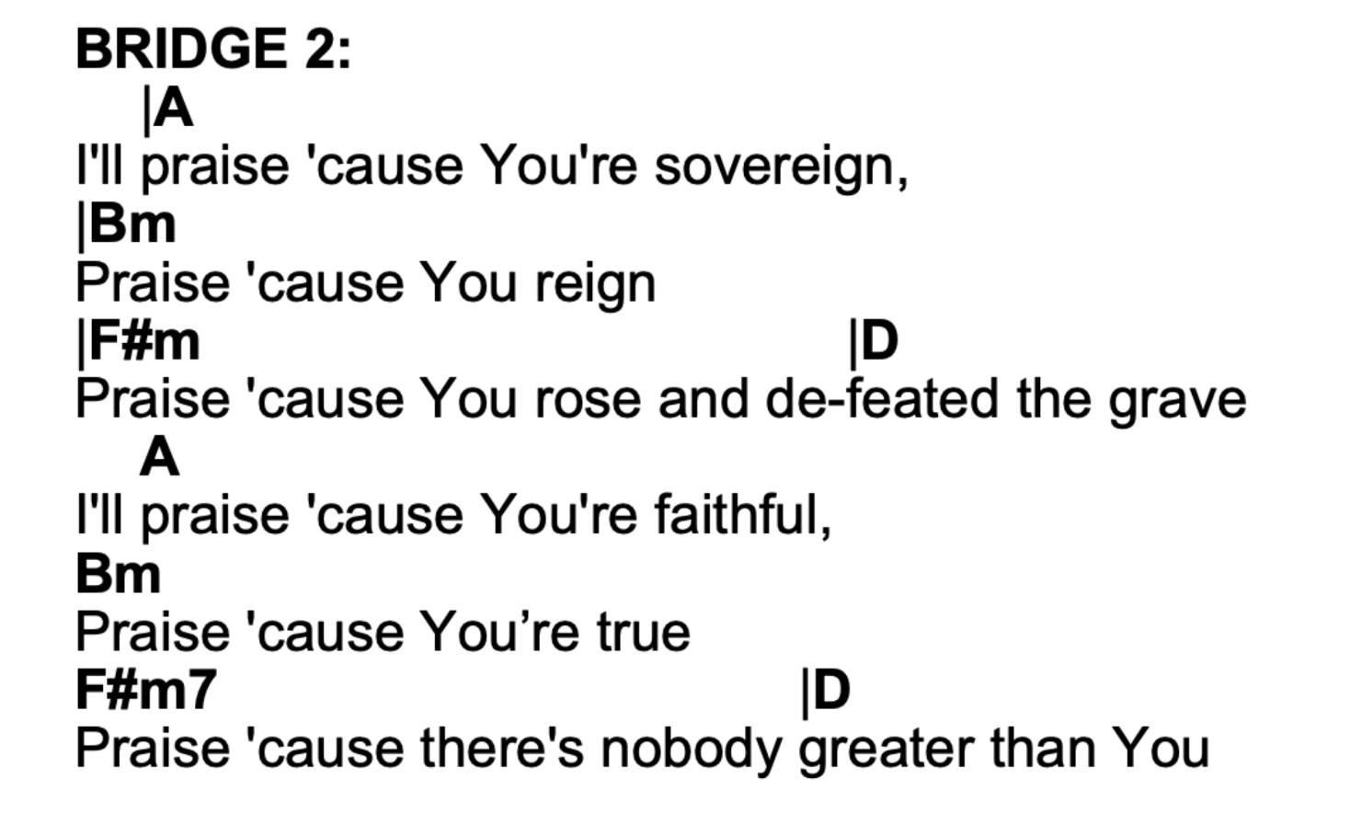
Practice Worksheet
“Praise” by Elevation Worship
Notes:
PEYTON: Write the corresponding Nashville Number chord next to the letter chord.

Slide 12
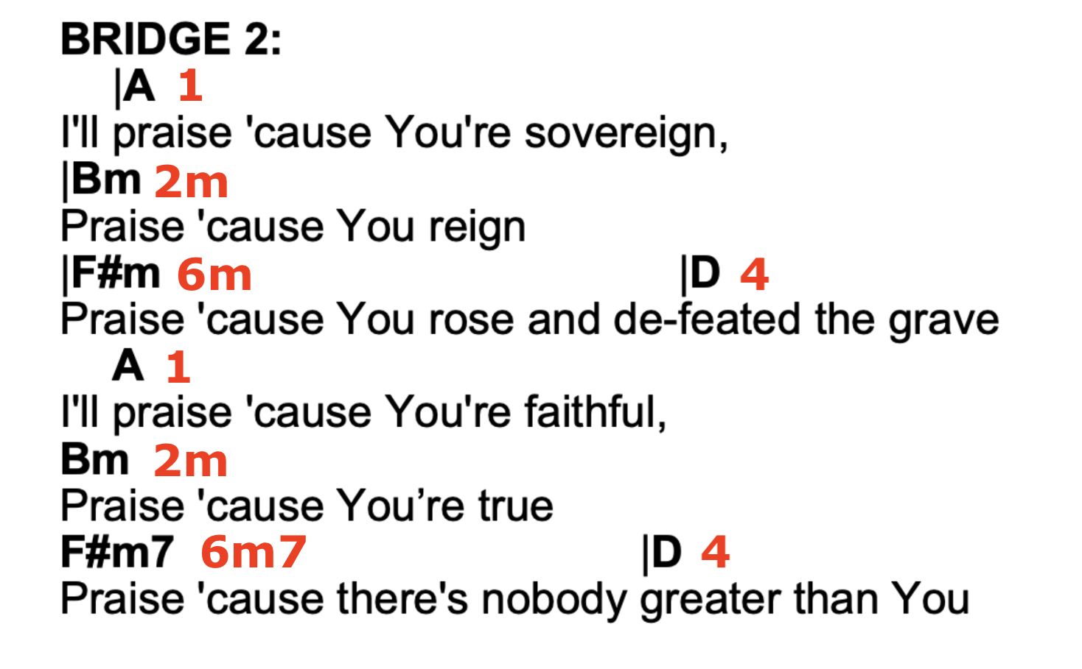
Practice Worksheet
“Praise” by Elevation Worship
Notes:
PEYTON: Here are the numbers that you will see written on the number chart in Planning Center. Let’s do another one.

Slide 13
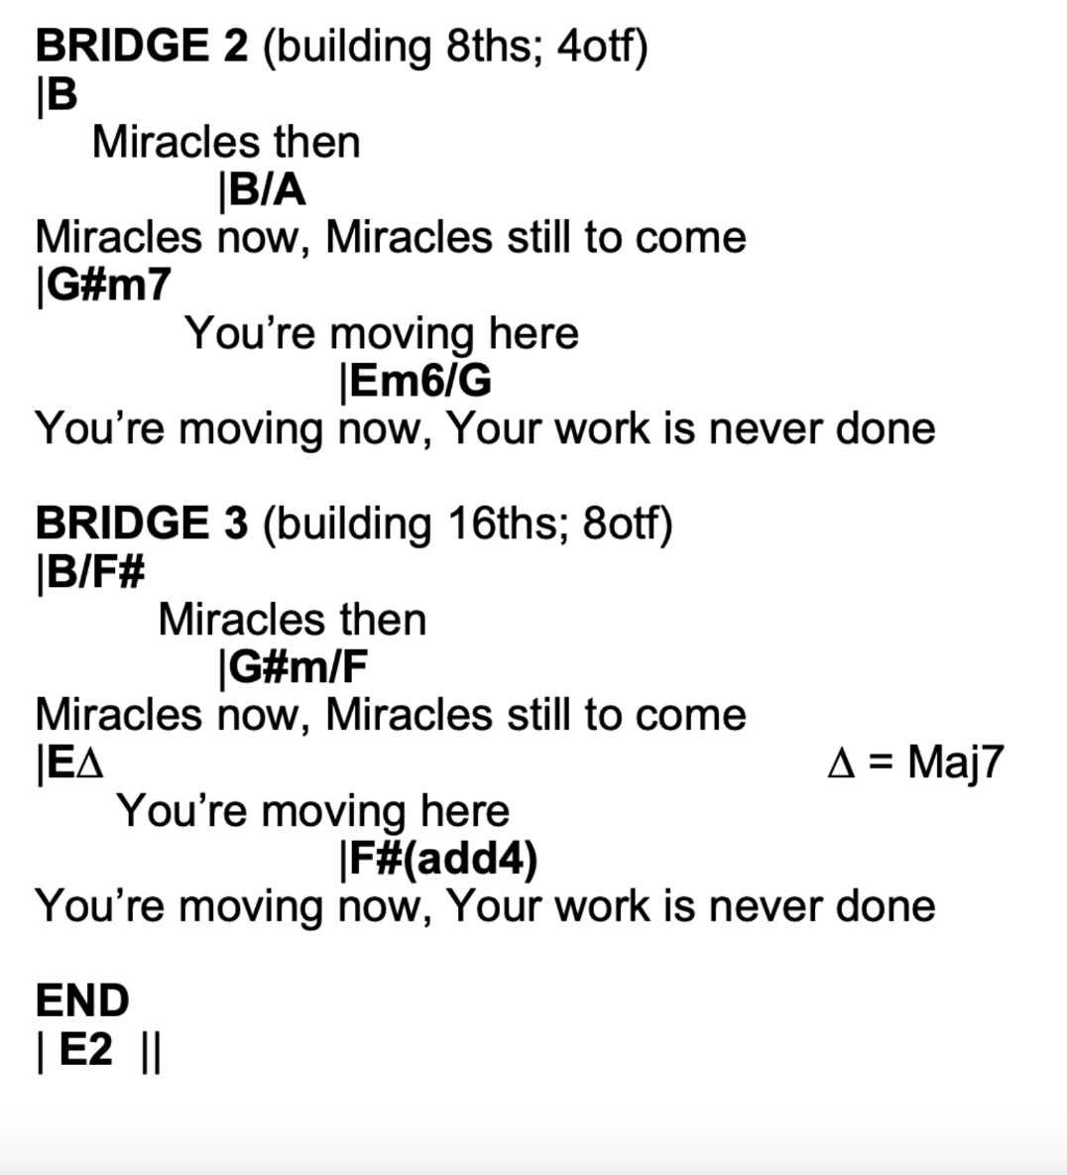
Practice Worksheet
“Nothing too Hard” by Liberty Live Worship
Notes:
PEYTON: Let’s do this one together, since it’s tough.

Slide 14
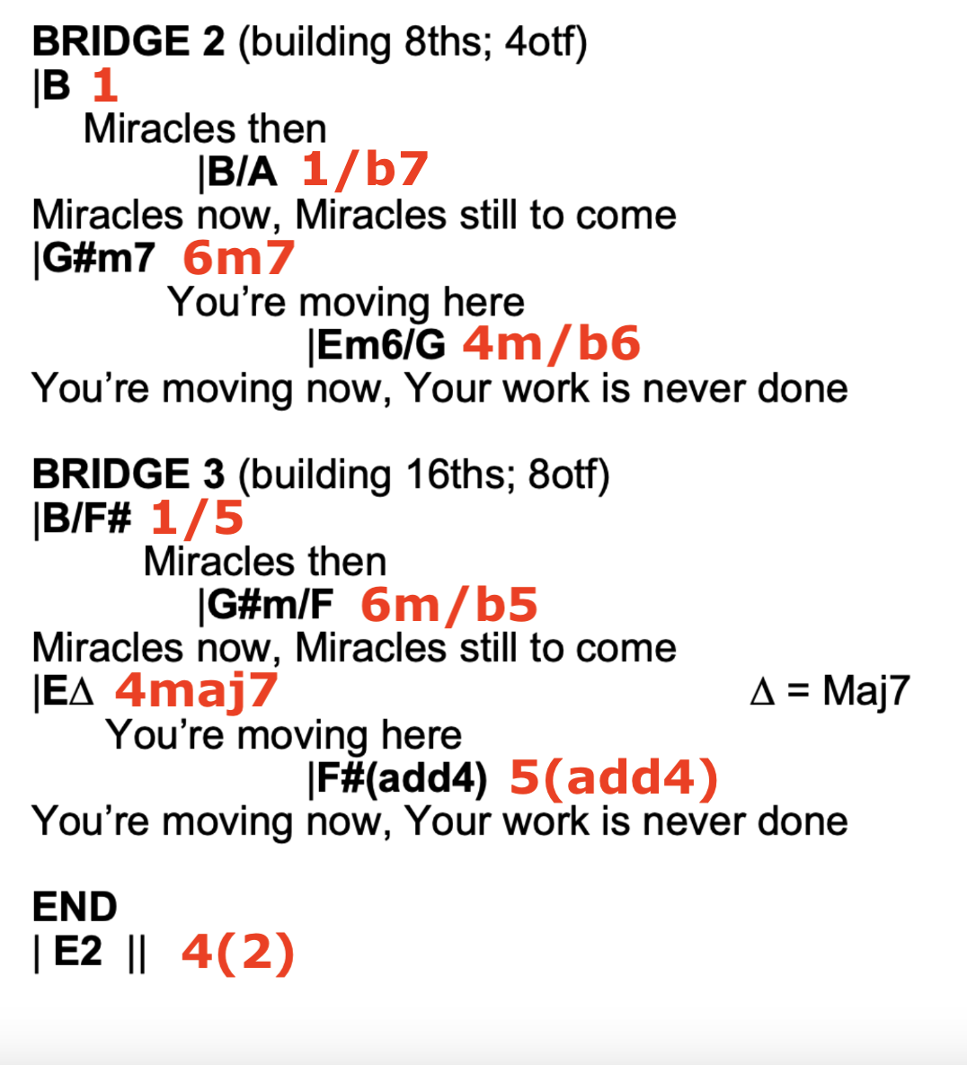
Practice Worksheet
“Nothing too Hard” by Liberty Live Worship
Notes:
PEYTON: Here is what you will see on the number chart in Planning Center. (Some symbols may look different i.e. ”4(2) and “4maj7”.)
To help you learn Nashville Numbers faster, we’ve created a little “cheat sheet” for you. [next slide]

Slide 15
Notes:
PEYTON: If you know what key you’re in, then you can quickly and easily assign Nashville Numbers to the letter chords on your chart.
Lucas, we’ve talked a lot about what Nashville Numbers are, but can you bring us into the conversation of how we will be integrating them into everything we do during worship services?

Slide 16
Using Nashville Numbers in Worship
Notes:
LUCAS
*DISCLAIMER* If you don’t know chord or note names on your instrument, learn them!
Apply Nashville Numbers to your instruments!
Understand MD’s callouts (Number vs. beat callouts. Ex: “Four on one!”)
Follow the MD (be able to hear them!)
Sense WL’s direction during worship set (especially for MD’s)
Sense CP’s direction while underscoring (unique personalities)

Slide 17
Using Nashville Numbers in Worship
Notes:
LUCAS
Remember our mission
Our role as worship life team members is to help usher people from a place of observation to participation... this happens in part by eliminating distractions, and playing skillfully in order to create engaging worship environments.
“In every service, we seek to journey people up the mountain to the top where the view is best, and where the glory of God is called down, and His life-changing, manifest presence is experienced.” Everything we do contributes to this journey.
Now that you are equipped…
Practice makes progress! We’re after excellence, not perfection.
Use handouts for practice.

Slide 18
Questions?
Notes:
LUCAS
Questions?

Slide 19
Contact us
Lucas (Central Music Producer) – Lmeinerding@libertylive.church
Greg (Central Music Director) – Gvarner@libertylive.church
Peyton (Smithfield Worship Director) – Plittleton@libertylive.church
Notes:
LUCAS
Contact us with any additional questions! We are here for you!
Closing (picture by fireplace @ 12:25)!
Prayer, & Dismissal

